Slide 1

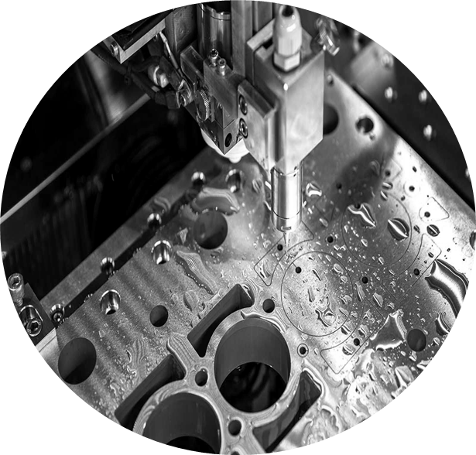
Aurelian Manufacturing
Production as a Service
Autonomous, Data-Driven, and Scalable

Slide 2
Who We Are
A business that scales with the combined value of skilled people and machines.
Aurelian Manufacturing delivers autonomous, high-mix/low-volume (HMLV) CNC machining with unprecedented efficiency and reliability.
Target market is demanding sectors like defense, energy, maritime, and critical industrial sectors with:
Turning and milling services in lights-out environment.
High machine utilization vs. industry 30-40%.
Full digital traceability from order to delivery.
Customer-aligned value model with shared benefits.
Sweet Spot
60-65%
Machine Utilization
Lights-Out
Autonomous Operation

Slide 3




The HMLV Landscape
We understand what drives excellence in High-Mix/Low-Volume production
Linear Operations Model
Greenfield Advantage
Manual to semi-automatic processes require significant human intervention. Each setup, adjustment, and quality check depends on operator skill and availability—limiting scalability and consistency.
Designing HMLV operations from scratch enables purpose-built automation, integrated digital systems, and optimized workflows—without legacy constraints or retrofit compromises.
Skilled Workforce Evolution
Smart Factory Architecture
Excellence in HMLV requires transitioning from manual operators to automation specialists—engineers who design, monitor, and optimize autonomous systems rather than run individual machines.
True HMLV leadership demands integrated digital infrastructure: automated CAM, real-time monitoring, predictive maintenance, and full traceability—not incremental automation additions.

Slide 4



The Aurelian Approach
Extreme Automation
Industry-Leading Efficiency
Full Digital Traceability
Lights-out HMLV operation. High uptime and minimal human intervention
60-65% utilization vs. industry 30-40%, translating to competitive pricing
Complete visibility from order to delivery with integrated quality control

Slide 5



Digital Infrastructure
What You Get Beyond Machining Services
eSECURITY – IT/OT & Value Chain Security
Zero-trust architecture protecting your data and ensuring compliance for defense and critical industries
eDOC – Digital Documentation & Traceability
Full traceability from order → CAM → production → measurement → delivery. Single source of truth for both parties
eMRB – Digital Deviation Management
Systematic quality control with traceable decisions, reducing risk and improving first-time-right performance

Slide 6

Customer Benefits
Reduced lead times through lights-out automation
Lower supply chain risk with reliable backup capacity
Full transparency and traceability for regulatory compliance
Competitive pricing through extreme automation efficiency
Quality consistency with digital quality control
Flexible capacity scaling as your needs grow

Slide 7


Collaboration Models
Flexible Engagement Options
Collaboration Framework
Shared performance upside
Secured machining capacity
Customer-influenced shop scale-up
Reporting and quality reviews within Aurelian’s digital platform (mrb’s).
Built on Trust
Aurelian ⟷ Customer
Long-term thinking
Mutual success
Transparent communication

Slide 8
Production Capabilities
Current Capacity:
• Location: Våler, Østfold
• First phase: 2,635 m² production floor
• Initial: 8 CNC machines, automation cells.
• Scalable to 20-25 machines in same facility
Strategic Infrastructure:
• Multi-modal logistics (rail, sea, road and air)
• 30,000 m² total buildable area
• Partnership with Mazak (tier-1 CNC supplier)
Q3 2027
First Production
12 Months
From Investment to Production
Mazak Partnership

Slide 9
Quality & Compliance
Full Traceability
Digital Quality Control
Component tracked from raw material to delivery.
Automated measurement and documentation (eMRB, eDOC)
Regulatory Compliance
Continuous Improvement
We build for defense, energy, and critical industry standards. Customer influenced.
Data-driven processes, AI optimization and (self)learning.

Slide 10
Why Choose Aurelian
Factor | Traditional Shops | Aurelian
Machine Utilization | 30-40% | 60-65%
HMLV Flexibility | Limited | Optimized
Digital Traceability | Manual/Partial | Full End-to-End
Pricing Model | Standard Markup | Efficiency + Performance upside
Automation Level | Semi-automated | Lights-Out Operation
Lead Time Predictability | Variable | Highly Predictable

Slide 11

Getting Started
1. Initial Discussion
Understanding your production requirements and volume forecasts
2. Capability Assessment
Review technical specifications and quality requirements
3. Partnership Structure
Discuss pre-qual, service agreement or strategic partnership options
4. Pilot Production
Start with sample parts to demonstrate quality and efficiency
5. Full Production Launch
Scale to ongoing production with full digital integration

Slide 12
Let's Build Together
Aurelian Manufacturing
Production as a Service
Contact us to discuss your manufacturing needs
Våler, Østfold | Norway

